Slide 1
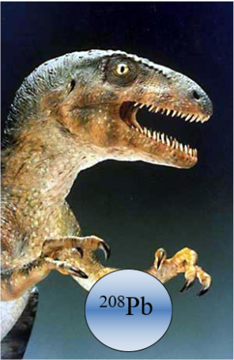
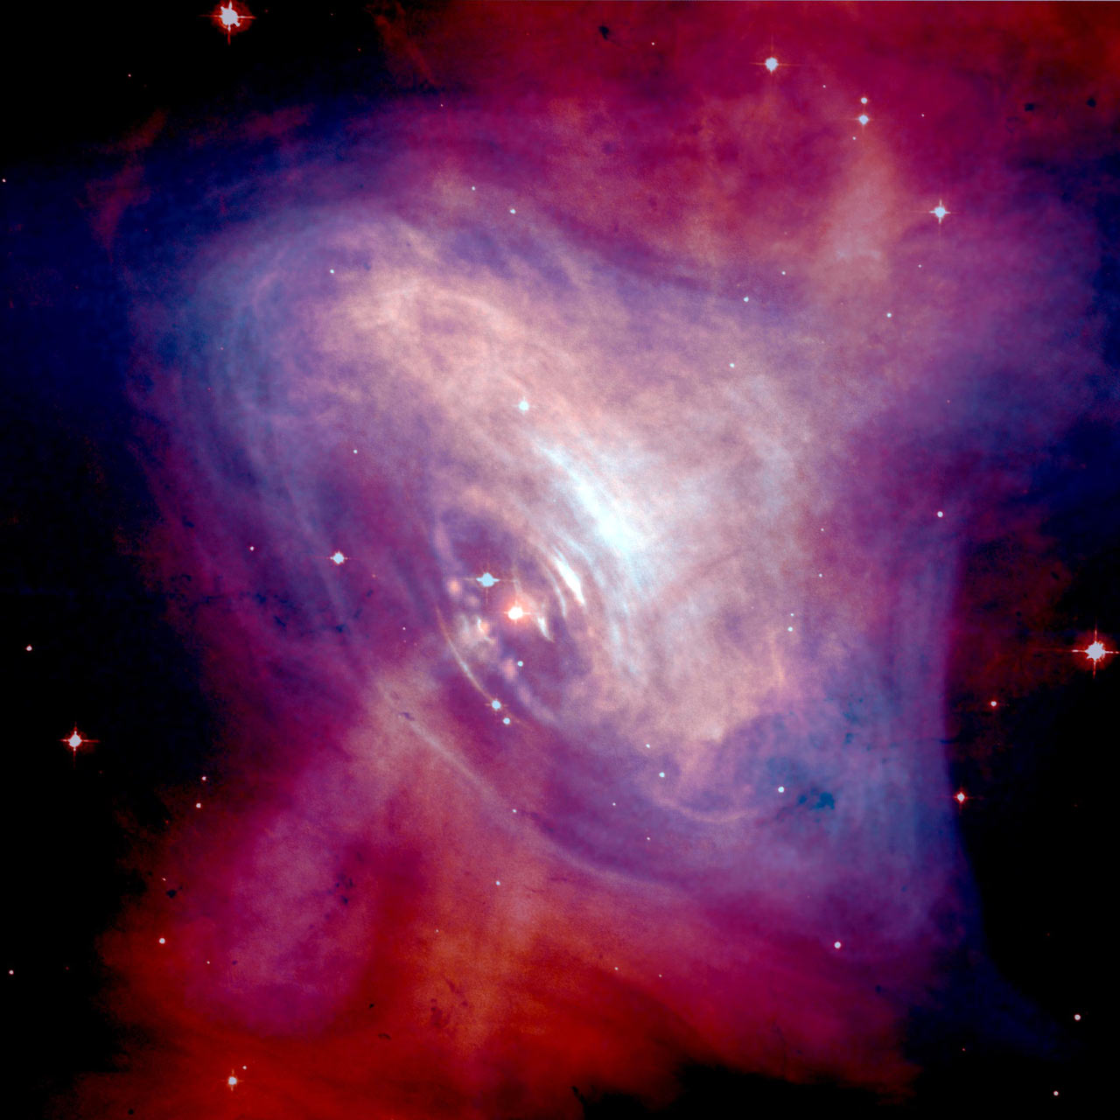
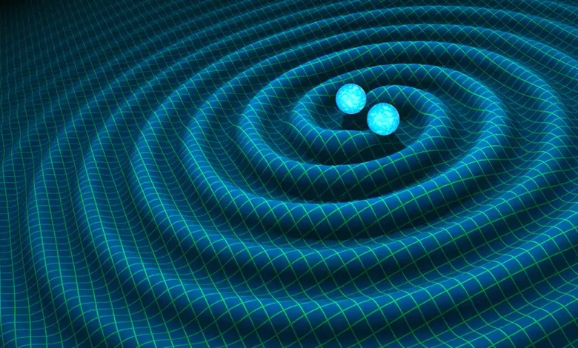
Density Functional Theory and the Nuclear EOS
Brendan Reed
2025 Frontiers Summer School
LA-UR-25-24566

Slide 2
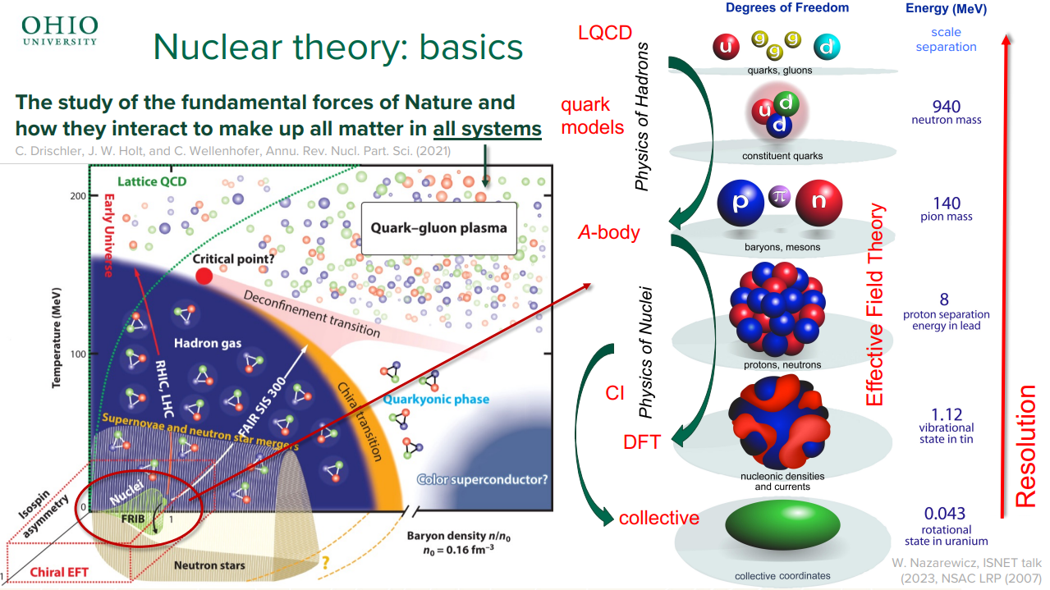
Recap

Slide 3
Recap

Slide 4
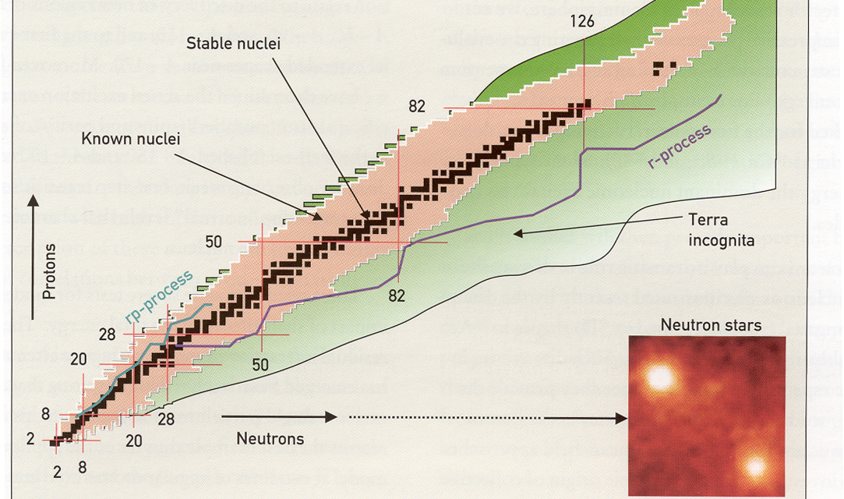
Nuclear Landscape

Slide 5
Nuclear Landscape

Slide 6
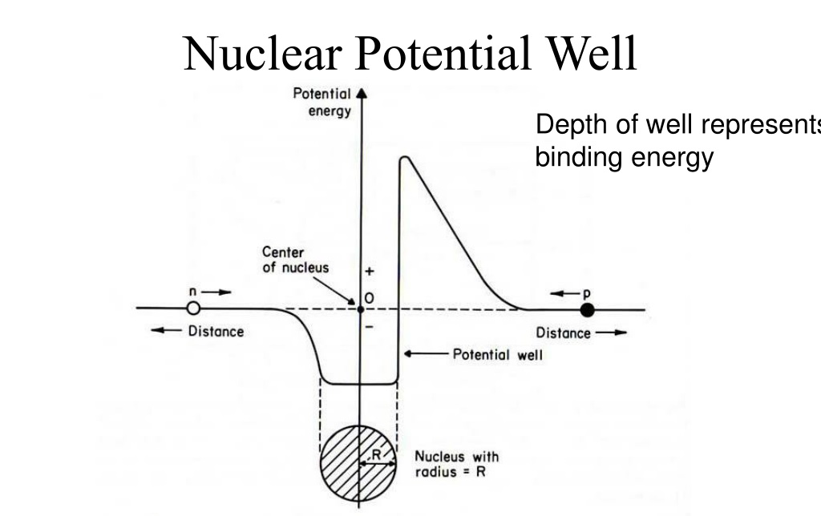
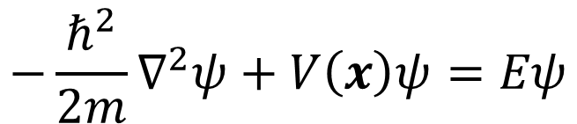
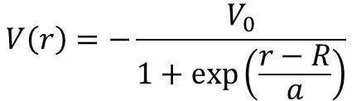
Nuclear Potential
$$−\frac{ℏ^{2}}{2m}∇^{2}ψ+V\left(x\right)ψ=Eψ$$
Observed from nuclear scattering
Depth of well depends on nuclear system
Characterizes nuclear forces and coulomb
$$V\left(r\right)=−\frac{V_{0}}{1+\exp\left(\frac{r−R}{a}\right)}$$
Woods-Saxon

Slide 7
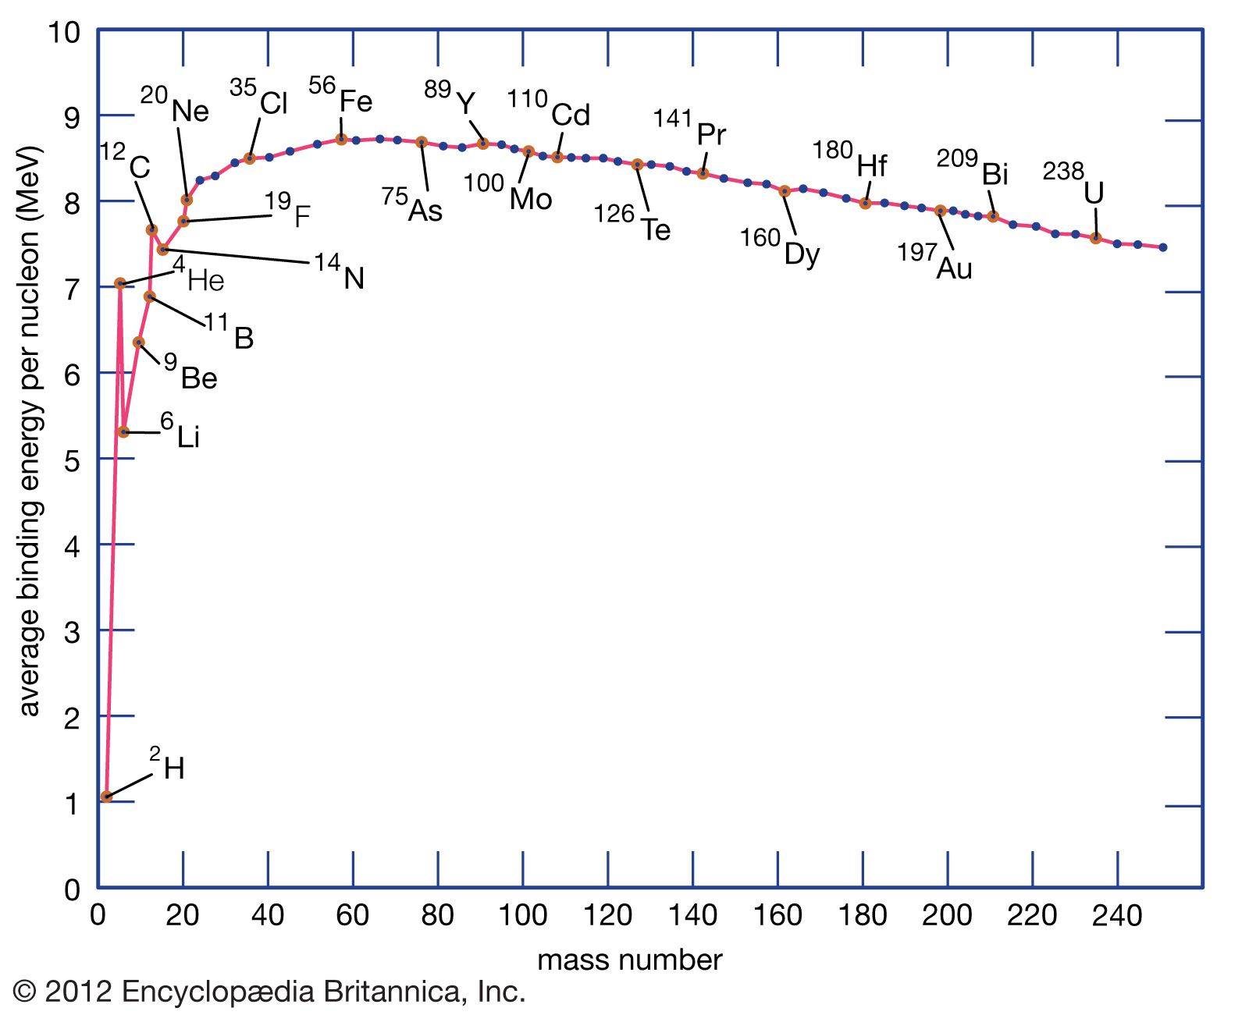
Fission
Move towards least energy
Fusion

Slide 8
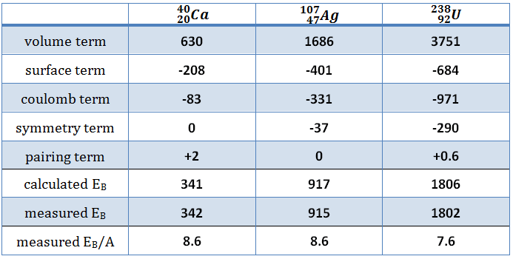
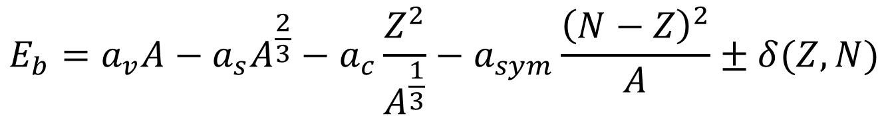
Incompressible Liquid Drop Model
Discrete equation for arbitrary (Z,N)
Coefficients determined from fits to nuclei
Semi-Empirical
Breaks down for infinite matter
Volume (bulk)
Surface
Coulomb
Symmetry
Pairing
$$E_{b}=a_{v}A−a_{s}A^{\frac{2}{3}}−a_{c}\frac{Z^{2}}{A^{\frac{1}{3}}}−a_{sym}\frac{{\left(N−Z\right)}^{2}}{A}±δ(Z,N)$$

Slide 9
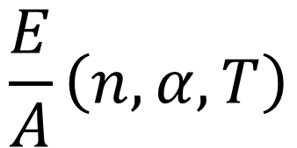
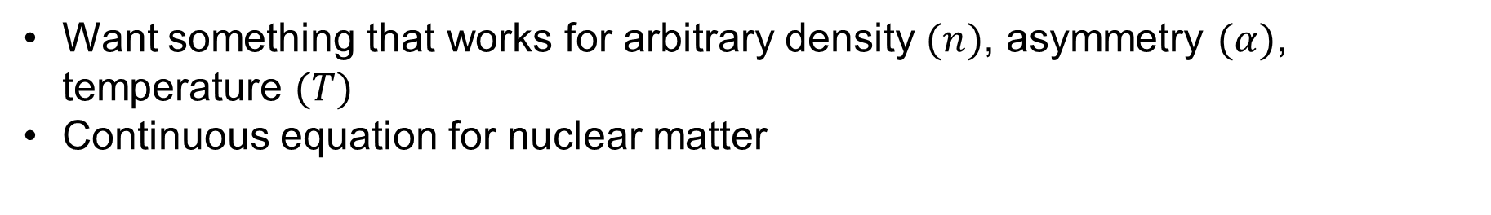
Compressible Equation
Want something that works for arbitrary density $(n)$, asymmetry $(α)$, temperature $(T)$
Continuous equation for nuclear matter
$$\frac{E}{A}\left(n,α,T\right)$$

Slide 10
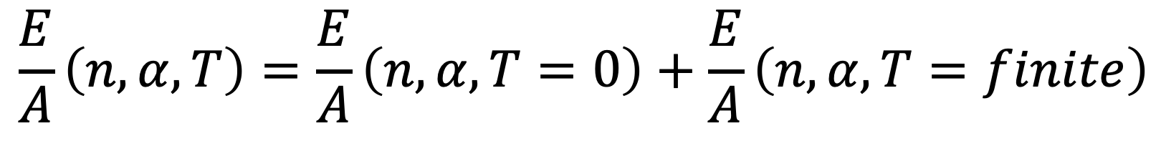
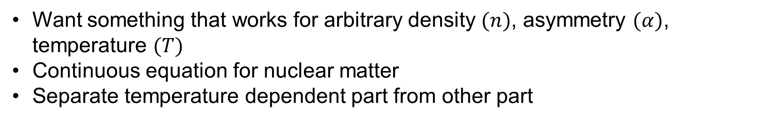
Compressible Equation
Want something that works for arbitrary density $(n)$, asymmetry $(α)$, temperature $(T)$
Continuous equation for nuclear matter
Separate temperature dependent part from other part
$$\frac{E}{A}\left(n,α,T\right)=\frac{E}{A}\left(n,α,T=0\right)+\frac{E}{A}\left(n,α,T=finite\right)$$

Slide 11
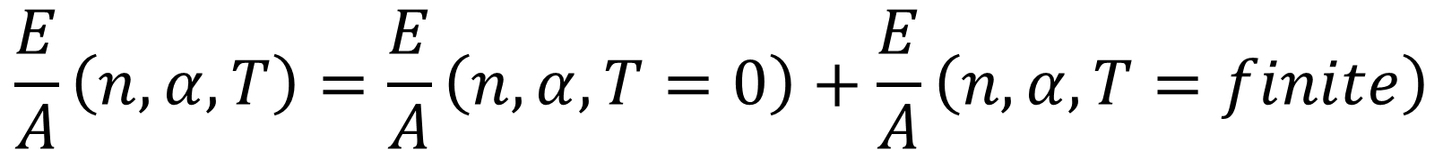
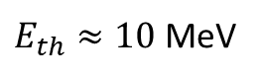
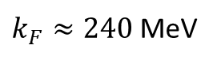
Compressible Equation
Want something that works for arbitrary density $(n)$, asymmetry $(α)$, temperature $(T)$
Continuous equation for nuclear matter
Separate temperature dependent part from other part
$$\frac{E}{A}\left(n,α,T\right)=\frac{E}{A}\left(n,α,T=0\right)+\frac{E}{A}\left(n,α,T=finite\right)$$
Complicated, useful in proto-NSs, BNS collisions, and supernovae
$k_{F}≈240$ MeV
$E_{th}≈10$ MeV

Slide 12
Compressible Equation
Want something that works for arbitrary density $(n)$, asymmetry $(α)$, temperature $(T)$
Continuous equation for nuclear matter
Separate temperature dependent part from other part
$$\frac{E}{A}\left(n,α,T\right)=\frac{E}{A}\left(n,α,T=0\right)+\frac{E}{A}\left(n,α,T=finite\right)$$
Focus on this part

Slide 13
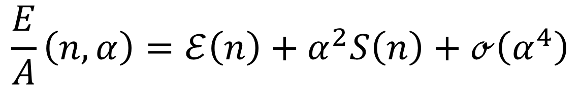
Nuclear Equation of State
Taylor expand in powers of nuclear asymmetry
$$\frac{E}{A}\left(n,α\right)=ℰ\left(n\right)+α^{2}S\left(n\right)+ℴ\left(α^{4}\right)$$

Slide 14
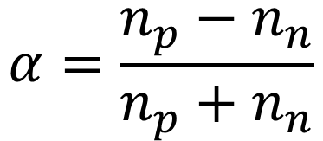
Nuclear Equation of State
Taylor expand in powers of nuclear asymmetry
$$\frac{E}{A}\left(n,α\right)=ℰ\left(n\right)+α^{2}S\left(n\right)+ℴ\left(α^{4}\right)$$
Energy of symmetric nuclear matter
Symmetry energy
$$α=\frac{n_{p}−n_{n}}{n_{p}+n_{n}}$$

Slide 15
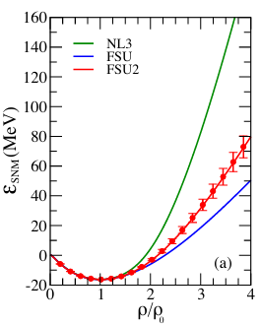
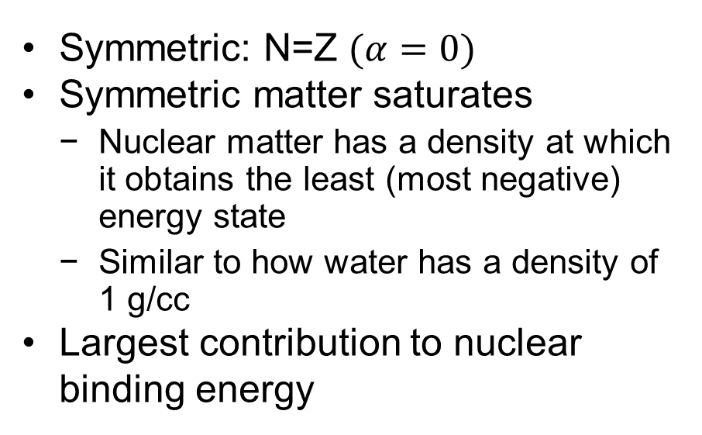
Energy of Symmetric Nuclear Matter
Symmetric: N=Z $(α=0)$
Symmetric matter saturates
Nuclear matter has a density at which it obtains the least (most negative) energy state
Similar to how water has a density of 1 g/cc
Largest contribution to nuclear binding energy
Chen & Piekarewicz (2014)

Slide 16
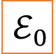
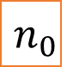
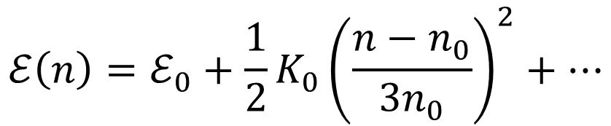
Energy of Symmetric Nuclear Matter
Symmetric: N=Z $(α=0)$
Symmetric matter saturates
Nuclear matter has a density at which it obtains the least (most negative) energy state
Similar to how water has a density of 1 g/cc
Largest contribution to nuclear binding energy
$$n_{0}$$
$$ℰ\left(n\right)=ℰ_{0}+\frac{1}{2}K_{0}{\left(\frac{n−n_{0}}{3n_{0}}\right)}^{2}+…$$
$$ℰ_{0}$$
Chen & Piekarewicz (2014)

Slide 17
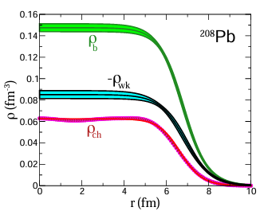

Slide 18
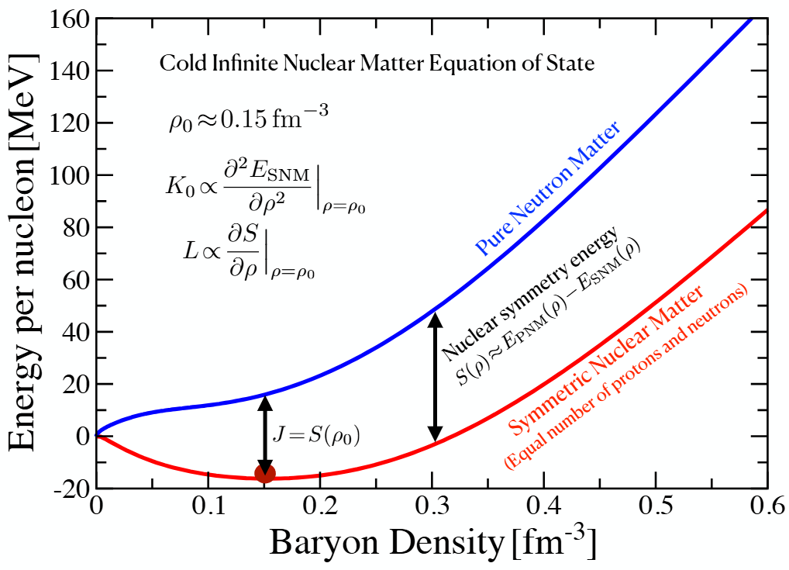
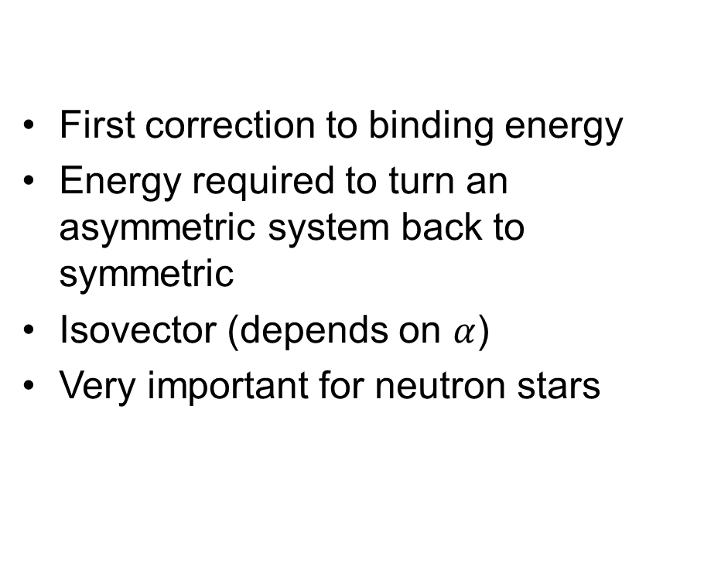
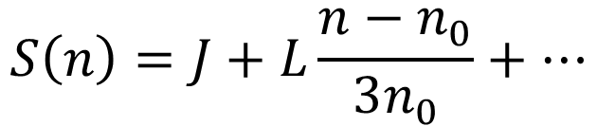
Symmetry Energy
First correction to binding energy
Energy required to turn an asymmetric system back to symmetric
Isovector (depends on $α$)
Very important for neutron stars
$$S\left(n\right)=J+L\frac{n−n_{0}}{3n_{0}}+…$$

Slide 19
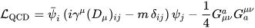
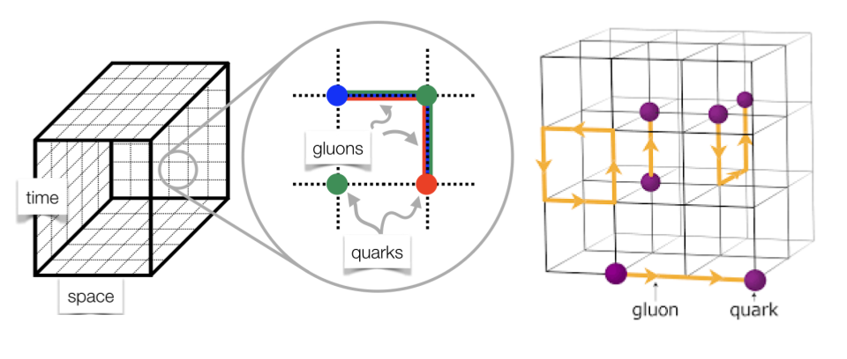
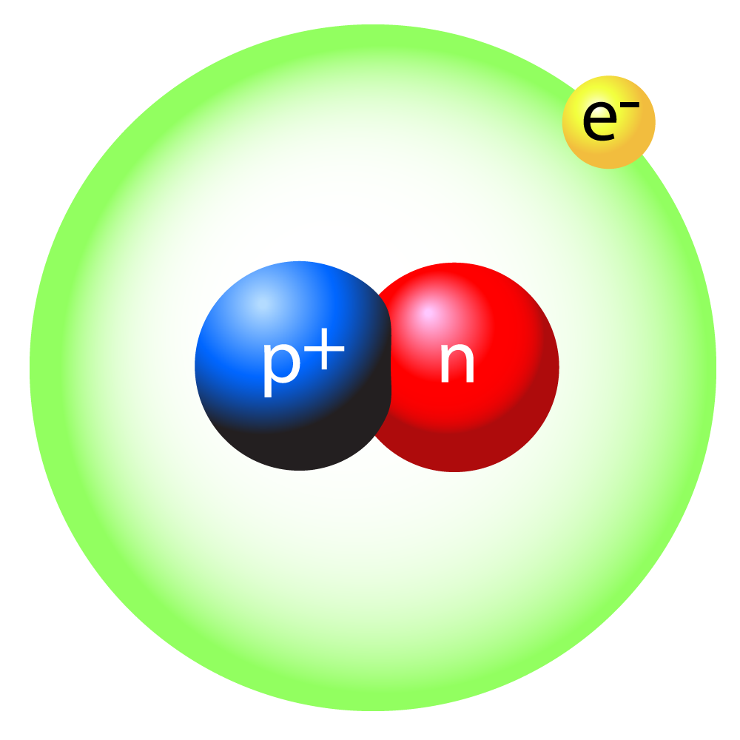
Role of Density Functionals
Modelling nuclear potential accurately is hard

Slide 20
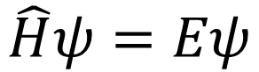
Role of Density Functionals
Rely on approximations and known particle behaviors to achieve observables you want
$$\hat{H}ψ=Eψ$$

Slide 21
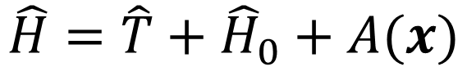
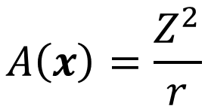
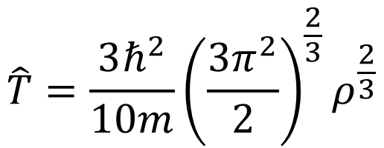
Role of Density Functionals
Rely on approximations and known particle behaviors to achieve observables you want
$$\hat{H}ψ=Eψ$$
$$\hat{H}=\hat{T}+{\hat{H}}_{0}+A(x)$$
$$\hat{T}=\frac{3ℏ^{2}}{10m}{\left(\frac{3π^{2}}{2}\right)}^{\frac{2}{3}}ρ^{\frac{2}{3}}$$
$$A\left(x\right)=\frac{Z^{2}}{r}$$
From Fermi-Dirac theory

Slide 22
Role of Density Functionals
Rely on approximations and known particle behaviors to achieve observables you want
$$\hat{H}ψ=Eψ$$
$$\hat{H}=\hat{T}+{\hat{H}}_{0}+A(x)$$
$$\hat{T}=\frac{3ℏ^{2}}{10m}{\left(\frac{3π^{2}}{2}\right)}^{\frac{2}{3}}ρ^{\frac{2}{3}}$$
$$A\left(x\right)=\frac{Z^{2}}{r}$$
?
From Fermi-Dirac theory

Slide 23
Non-relativistic vs. Relativistic
Pros
Cons
Non-relativistic
Easier to implement (generally)
Operators well-defined
Good performance at low-density and with lighter nuclei
Relativistic
Naturalness
Good behavior at high density and heavy nuclei
Particle interactions arise easier
Non-relativistic
Poor behavior at high density
Slow convergence in finite nuclei
Relativistic
More difficult to implement
Some quantities not well defined
Operators mix together

Slide 24
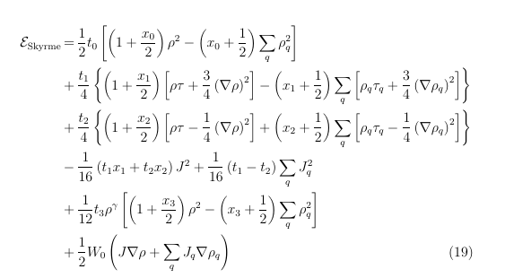
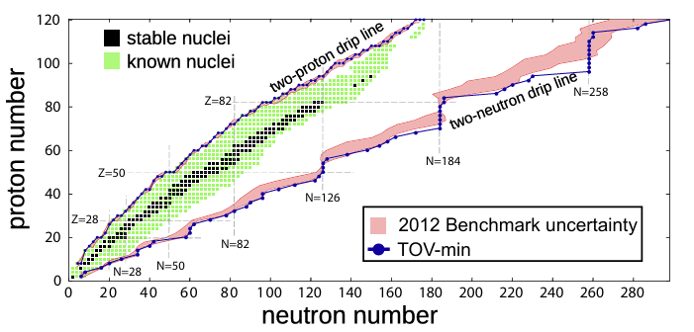
Skyrme Functional
Non-relativistic mean-field model
Developed in 50s alongside Hartree-Fock-Bogolyubov (see more later)
Very popular and successful due to its relative simplicity
Erler+ (2012)

Slide 25
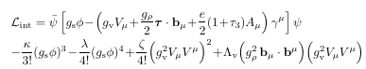
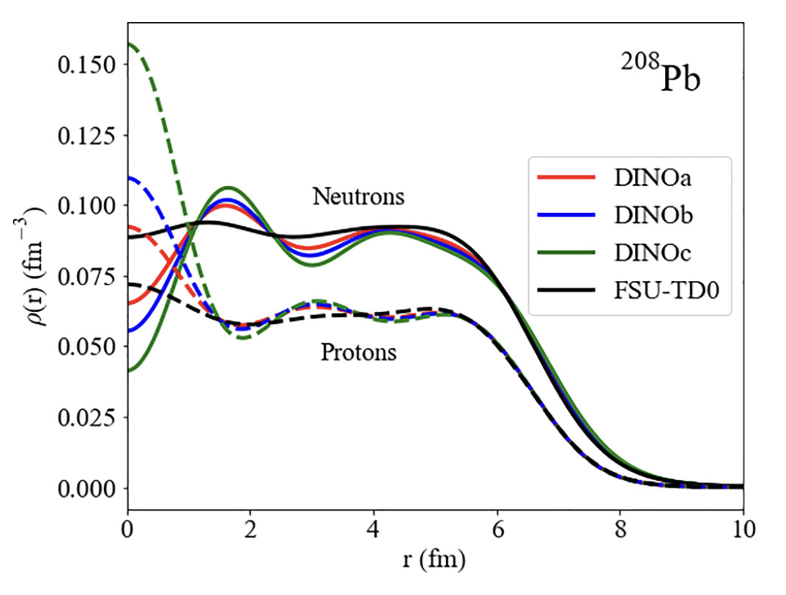
Relativistic Mean-Field Theory
Covariant mean-field theory
Developed in 1970s by Walecka
Popular for its accuracy for large A nuclei and neutron stars
Forces arise from known particle interactions in QHD

Slide 26
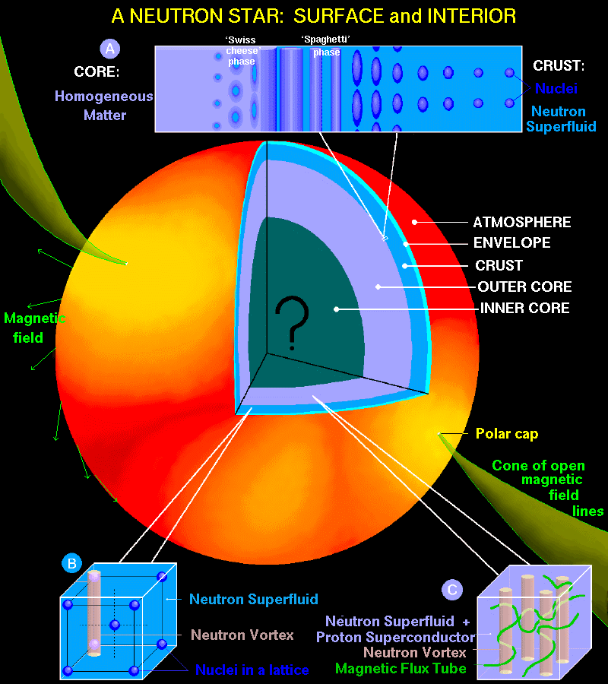
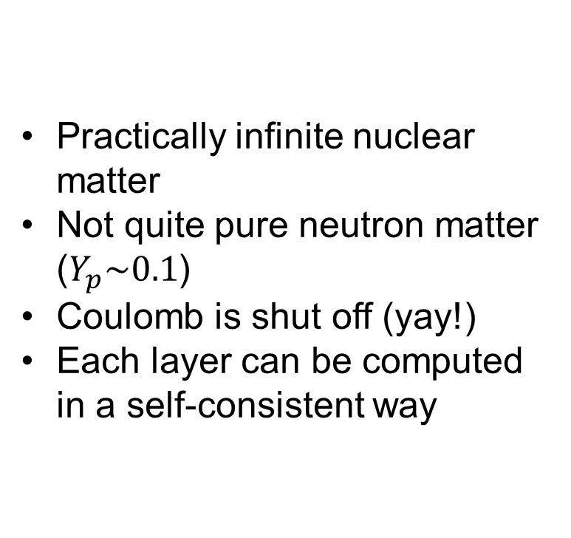
Applications: Neutron Stars
Practically infinite nuclear matter
Not quite pure neutron matter ($Y_{p}\sim 0.1$)
Coulomb is shut off (yay!)
Each layer can be computed in a self-consistent way

Slide 27
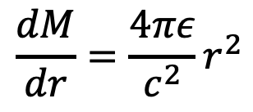
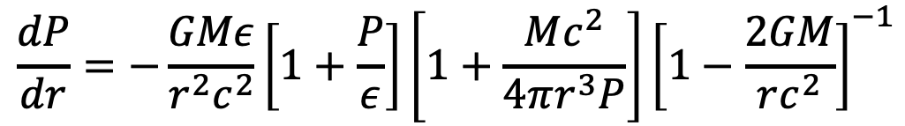
Structure Equations
$$\frac{dP}{dr}=−\frac{GMε}{r^{2}c^{2}}\left[1+\frac{P}{ε}\right]\left[1+\frac{Mc^{2}}{4πr^{3}P}\right]{\left[1−\frac{2GM}{rc^{2}}\right]}^{−1}$$
Tolman-Oppenheimer-Volkoff Equations
$$\frac{dM}{dr}=\frac{4πε}{c^{2}}r^{2}$$

Slide 28
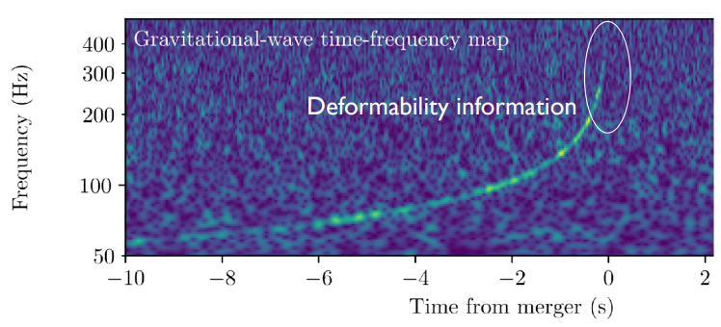
Gravitational waves
Aug. 17, 2017: merger of two NS observed by LIGO-Virgo gravitational wave detectors
Fermi and Integral spacecrafts independently reported a short gamma ray burst
Extensive follow ups observed this event at wavelengths in each part of EM spectrum
Abbot et al. (2017)

Slide 29
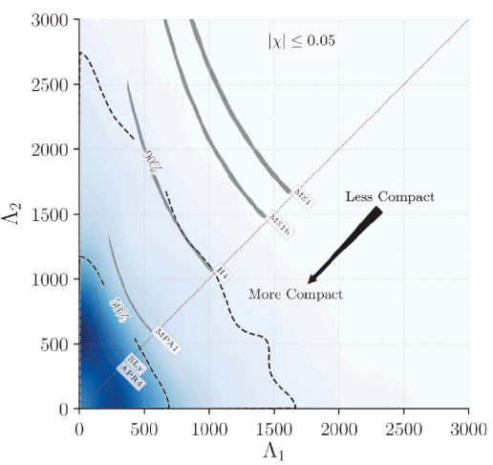
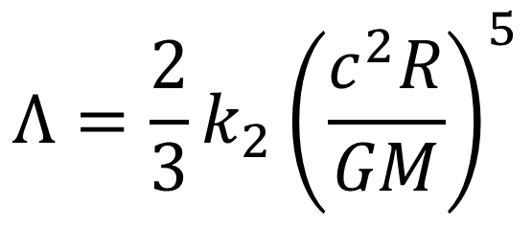
Tidal Deformability
Gravitational tides distort shapes of neutron stars just before merger
Similarly to dipole polarizability of an atom, the mass quadrupole polarizability (tidal deformability) of a NS scales as powers of R
GW170817 set upper limits on combined deformability of stars 1 and 2
Analysis favors more compact stars
$$Λ=\frac{2}{3}k_{2}{\left(\frac{c^{2}R}{GM}\right)}^{5}$$

Slide 30
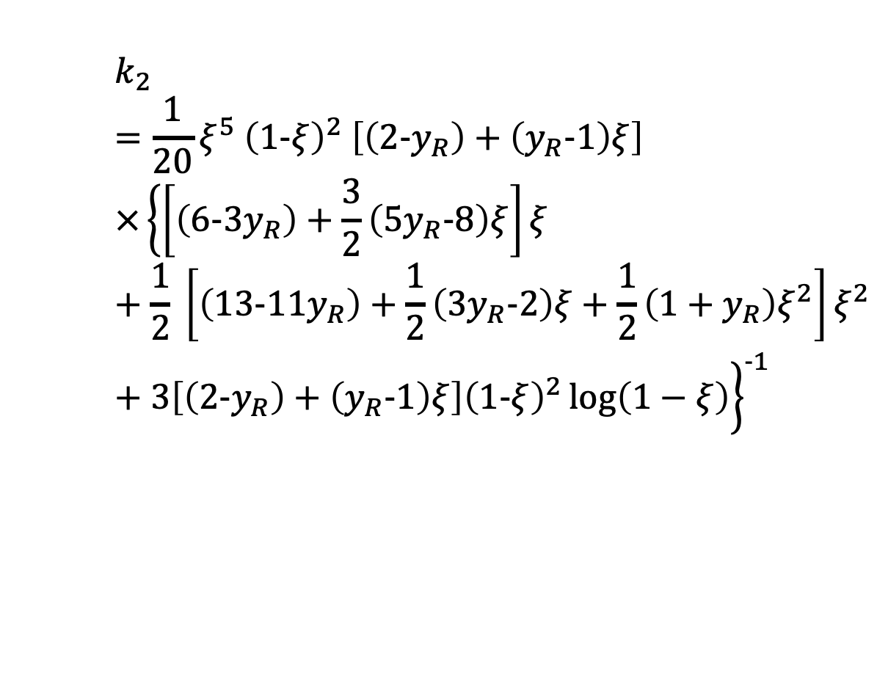
Structure Equations
$$\frac{dP}{dr}=−\frac{GMε}{r^{2}c^{2}}\left[1+\frac{P}{ε}\right]\left[1+\frac{Mc^{2}}{4πr^{3}P}\right]{\left[1−\frac{2GM}{rc^{2}}\right]}^{−1}$$
Tolman-Oppenheimer-Volkoff Equations
Second tidal Love number
Solve differential equation alongside TOV equations
$$\frac{dM}{dr}=\frac{4πε}{c^{2}}r^{2}$$
$$k_{2}=\frac{1}{20}ξ^{5} {\left(1-ξ\right)}^{2} \left[\left(2-y_{R}\right)+\left(y_{R}-1\right)ξ\right]×{\left\{\left[\left(6-3y_{R}\right)+\frac{3}{2}\left(5y_{R}-8\right)ξ\right]ξ+\frac{1}{2} \left[\left(13-11y_{R}\right)+\frac{1}{2}\left(3y_{R}-2\right)ξ+\frac{1}{2}\left(1+y_{R}\right)ξ^{2}\right]ξ^{2}+3\left[\left(2-y_{R}\right)+\left(y_{R}-1\right)ξ\right]{\left(1-ξ\right)}^{2}\log\left(1−ξ\right)\right\}}^{-1}$$

Slide 31
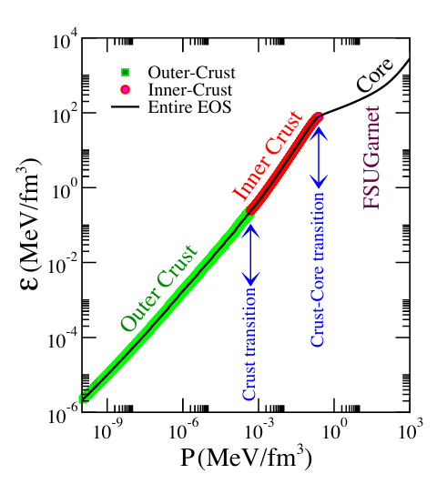
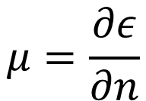



Neutron Star Core
Thermodynamics
Superconducting nuclear fluid of protons, neutrons, and leptons
Beta equilibrium
Can build NS EOS using first principles
$$n\underset{⇔}{}p+e$$
$$P=ε^{2}\frac{∂E}{∂ε}$$
$$μ=\frac{∂ε}{∂n}$$
$$ε_{F}=\frac{1}{π^{2}}\int_{0}^{k_{F}}{dk k^{2}\sqrt{k^{2}+m^{2}}}$$
Fattoyev+ (2019)

Slide 32
Neutron Star Core
Check out today’s activity!
Thermodynamics
Superconducting nuclear fluid of protons, neutrons, and leptons
Beta equilibrium
Can build NS EOS using first principles
$$P=ε^{2}\frac{∂E}{∂ε}$$
$$μ=\frac{∂ε}{∂n}$$
$$ε_{F}=\frac{1}{π^{2}}\int_{0}^{k_{F}}{dk k^{2}\sqrt{k^{2}+m^{2}}}$$
Fattoyev+ (2019)

Slide 33
Applications: Finite Nuclei
Need to employ more complicated methods
Hartree-Fock-Bogolyubov (HFB) is standard
Self-consistent solutions tend to be standard practice of solving
Hartree
Ground state nucleus
Fock
Exchange terms including pions
Bogolyubov
Pairing

Slide 34



Parity violating electron scattering
In Born approximation:
$$A_{pv}≈\frac{G_{F}q^{2}}{2πα\sqrt{2}}\frac{F_{W}\left(q^{2}\right)}{F_{ch}(q^{2})}$$
$$F_{W}\left(q^{2}\right)=\int{d^{3}r\frac{sin\left(qr\right)}{qr}}ρ_{w}(r)$$
Model independent way to map out distribution of weak charge in a nucleus
Coulomb distortions are included from numerical solution of Dirac equation
PV-asymmetry $A_{pv}$ is cross section difference between (+) and (-) helicity electrons
$A_{pv}$ arises from photon and Z-boson exchange interference
$$A_{pv}=\frac{\frac{dσ}{dΩ_{+}}−\frac{dσ}{dΩ_{−}}}{\frac{dσ}{dΩ_{+}}+\frac{dσ}{dΩ_{−}}}$$
Notes:
F is the fourier transform of the weak form factor
Neutrino scattering cross section goes like F^2
PREXII rapidly changes electron spins to get Apv

Slide 35


Experiment measured:
$A_{pv} =550±18.1$ ppb
Notes:
Uncertainty quoted is combined from systematic and statistical uncertainty

Slide 36


Neutron stars and Pb208
Pressure of neutron matter pushes neutrons out against surface tension
Neutron skin correlated with pressure of neutron matter
Radius of a neutron star also depends on pressure of neutron matter
Remarkably, PREX-II measurement has important implications on the structure of neutron stars
$$P_{pnm}\left(n_{0}\right)≈\frac{1}{3}n_{0}L$$

Slide 37


Slide 38


Neutron Star Crust
Lorenz+ (1993)
Nonuniform matter
Very neutron-rich nuclei
Relativistic electrons
Sort of acts like infinite matter
Shell states blend together
Transition from crust to core determined by stability analysis
Caplan (2017)

Slide 39

Temperature-Dependent DFT
Have expressions for the total energy per particle
Use laws of thermodynamics to derive everything else
Utilize partition functions and level densities to accommodate temperature
Very involved, check out CompOSE
Shen+ (2011)

Slide 40
Conclusions
Nuclear EOS is important to model and understand
Modeling nuclear potential is active research
DFT approaches still relevant and useful
Neutron stars inform high density EOS
Finite nuclei inform densities around saturation

